Slide 1
I am a Healthy Kid
(For teachers)

Slide 2
During the period of deferral of class resumption, children should stay at home and avoid going to crowded places to minimize the risk of infection. Teachers can make reference to the following information in designing activities that meet children’s developmental needs. Teachers can also provide the relevant information to parents to strengthen children’s hygiene habits and advise parents to engage children in activities that promote their physical and psychological health. If screen activities are to be conducted, appropriate guidance and arrangement should be provided. Teachers and parents can browse the below website to understand the suggestions from Department of Health regarding children’s use of Internet and electronic screen products：
https://www.studenthealth.gov.hk/english/internet/report/report.html
2

Slide 3
Healthy Living
3

Slide 4
Personal hygiene
Centre for Health Protection, Department of Health
4

Slide 5
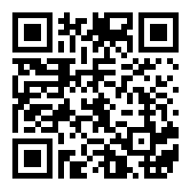
Centre for Health Protection “How to clean our hands properly” (Video)
Webpage:
https://www.youtube.com/watch?v=D96UulWqsFI
5

Slide 6
Parent-child reading activities
 Read the pamphlet from Centre for Health Protection with your children and introduce the message of hygiene to them
Family Health Service, Department of Health
Hand hygiene –
An easy and effective way to prevent infection
https://www.chp.gov.hk/files/her/hand_hygiene_pamphlet.pdf
6

Slide 7
Hand hygiene
Why perform hand hygiene?
When to perform hand hygiene?
Who should perform hand hygiene?
How to perform hand hygiene?
7

Slide 8
8

Slide 9
9

Slide 10
10

Slide 11
11

Slide 12
Wear Properly for Protection
cover the mouth, nose and chin
How to take off the mask?
1. Wash the hands first; 2. Avoid touching the outer side as there may be viruses.
the outer and inner side should not be mixed up
3. Discard the worn mask into a lidded rubbish bin and do not reuse;
4. Wash hands again.
12

Slide 13
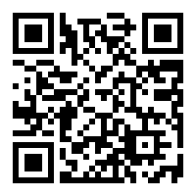
Centre for Health Protection “How to wear a surgical mask properly” (Video)
Webpage:
https://www.youtube.com/watch?v=gggtXTuhJek
13

Slide 14
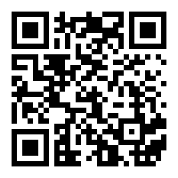
Centre for Health Protection “How to take off a surgical mask properly” (Video) & discard the mask properly
Webpage:
https://www.youtube.com/watch?v=D9M57hycc7A
14

Slide 15
Health Education
15

Slide 16
Healthy diet
Webpage of “StartSmart@school.hk” Campaign: https://www.startsmart.gov.hk/en/index.aspx
Origami and “Dot to Dot” games of healthy food
The path of the webpage :
StartSmart@school.hk > Kindergartens and Child Care Centres > Health Education Resources > Mini Games https://www.startsmart.gov.hk/en/others.aspx?MenuID=125
16

Slide 17
Parent-child cooking activities
Parents can make simple snacks together with children. Apart from promoting parent-child relationship, it can enhance their understanding of different food and also their interest in food.
Children will have the opportunity to use different tools to cut or mix food in the process of snack making, which facilitates their eye-hand co-ordination and fine motor development. Some examples of simple snack making include orange juice, fruit salad and sweet dumpling in soup.
The webpage of “StartSmart@school.hk” provides snack recipes for kids，the path is as follow：
Webpage of “StartSmart@school.hk” (https://www.startsmart.gov.hk) > Let’s Cook Smart > Snack Recipes for Kids
https://www.startsmart.gov.hk/en/others.aspx?MenuID=91
17

Slide 18
Dental Care
Webpage of “Tooth Club”
https://www.toothclub.gov.hk/en/en_pandc.html
 Games on dental care
The path of the webpage:
(https://www.toothclub.gov.hk/en/en_pandc.html) > Activities download
https://www.toothclub.gov.hk/en/en_pandc_download.html
18

Slide 19
Games and Physical Activities
19

Slide 20
Parents can recite the rhymes with children and create movements together
兒歌(一) : 洗手歌
扭開水龍頭 先來沖沖手
再用梘液搓 搓洗要足夠
雙手各部分 切記勿遺漏
大家勤洗手 病菌趕快走
(Nursery rhyme (1) Wash Your Hands
Turn the tap on together we wash
Water helps us get the germs off
Scrub, scrub, scrub with soap and water
Top, bottom, in between the fingers
Make sure the hands are clean and nice
Keeping the germs away is right)
20

Slide 21
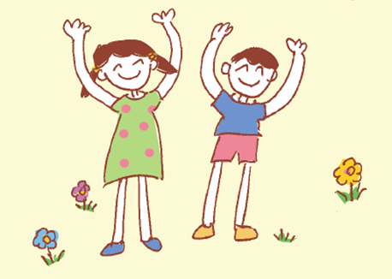
兒歌(二) : 我愛做運動
伸伸雙手彎彎腰
跑跑跳跳踏踏步
大家同來做運動
強健身體精神好
(Nursery rhyme (2) I Love Exercise
Stretch your hands and bend your waist
Run there jump here stamp your feet
Together let us exercise each day
To have a strong body and good spirit)
21

Slide 22
兒歌(三) : 吃水果
士多啤梨、蘋果、橙
營養豐富好味道
多汁解渴纖維高
愛吃水果身體好
(Nursery rhyme(3) Eating Fruits
Strawberries, apples, oranges
Fruits are nutritious and tasty
Juicy with fibre, quench your thirst
Eating fruits is good for all)
22

Slide 23
兒歌(四) :健康好寶寶
我是健康好寶寶
作息定時會做到
均衡飲食快長高
爸爸媽媽齊讚好
(Nursery rhyme 4 A Good Healthy Kid
I am certainly a good healthy kid
Regularly wake up and go to bed
With a balanced diet I grow tall
Good kid I am, said mom and dad)
23

Slide 24
Rhymes and movements
Webpage of “Educational Television, EDB” provides songs with different themes.
The weblinks are as follows:
兒歌專輯(一)「健康生活篇」
(The ‘Healthy Life’ Episode)
兒歌專輯(二)「自信自理篇」「愛己愛人篇」
(The ‘Self-Confidence & Self-Care’ Episode,
The ‘Love Youself & Others’ Episode
https://www.hkedcity.net/etv/en/resource/22182295
https://www.hkedcity.net/etv/en/resource/1870713412
24

Slide 25
Family Health Service,
Department of Health
Play and Creativity
https://www.fhs.gov.hk/english/health_info/child/13039.pdf
25

Slide 26
 Encourage children to help with simple household chores suitable for their abilities, such as folding quilts, watering plants, folding clothes, washing fruits and tidying up things after use, etc. These can help children learn to take care of themselves and nurture their sense of responsibility.
26

Slide 27
Webpage of the Hong Kong Wetland Park:
https://www.wetlandpark.gov.hk/en
3D Origami of wetland animals
The path of the webpage:
Webpage of Hong Kong Wetland Park
(https://www.wetlandpark.gov.hk) > Download Area >
Gadgets > 3D Origami
https://www.wetlandpark.gov.hk/en/download/gadgets-3d-origami
26

Slide 28
Reading Activities
28

Slide 29
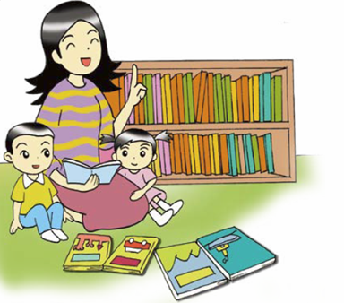
Storytelling
Using picture books to tell stories to your children in order to arouse their reading interest, let them love to read as well as learn to read
Webpage of “Educational Television, EDB”– Series of Being a Healthy Kid
https://www.hkedcity.net/etv/en/resource/2333591569
Theme: Healthy Living
Theme: Moral Education
28

Slide 30
Other References
30

Slide 31
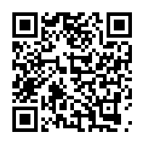
Centre for Health Protection, Department of Health “Information of Coronavirus Disease 2019”
Webpage: https://www.chp.gov.hk/en/healthtopics/content/24/102466.html
31

Slide 32
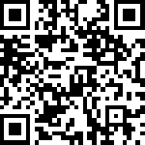
Online Resources about Coronavirus Disease 2019
The path of the webpage:
(https://www.chp.gov.hk/en/healthtopics/content/24/102466.html)
> Health Topics > Communicable Diseases > Coronavirus Disease 2019 (COVID-19)
Webpage: https://www.chp.gov.hk/en/resources/464/102466.html
32

Slide 33
Coronavirus Disease 2019 Information written in different ethnic minority languages are available in the following webpage. Teachers can retrieve related information to parents of ethnic minorities for reference:
हिन्दी (Hindi Version)
नेपाली (Nepali Version)
اردو (Urdu Version)
ไทย (Thai Version)
Bahasa Indonesia (Bahasa Indonesia Version)
Tagalog (Tagalog Version)
Tiếng Việt (Vietnamese Version)
網址： https://www.coronavirus.gov.hk/eng/index.html
32

Slide 34
Wish you Good Health!

